Slide 1
Youth Unemployment In the MENA Region
ANNUAL WORKSHOP 2023
How can technology boost entrepreneurship at scale?
Lessons learned from World Bank case studies
HISHAM JABI
25 JANUARY 2023
SCAN TO JOIN THE COMMUNITY OF PRACTICE ONLINE!

Slide 2
TODAY’S PRESENTATION
The scale of youth unemployment in the MENA region
The scope of the report
Approach to understanding how technology boosts entrepreneurship
Key learnings
Highlight: Three case studies

Slide 3
THE SCALE OF YOUTH UNEMPLOYMENT IN THE MENA REGION
250 million
More than half the MENA population- nearly - are under the age of 30
32%
Nearly 1 in 3 youth, aged 15 to 24 in MENA are not engaged in employment, education, or training (NEET)
26%
The youth unemployment rate in MENA is the highest in the world at about
77%
The share of informal employment is estimated at of total employment in Morocco, in Egypt, and in WBG
69%
64%
77%; the lowest in the world
Female labor participation is at about
Source: The World Bank

Slide 4
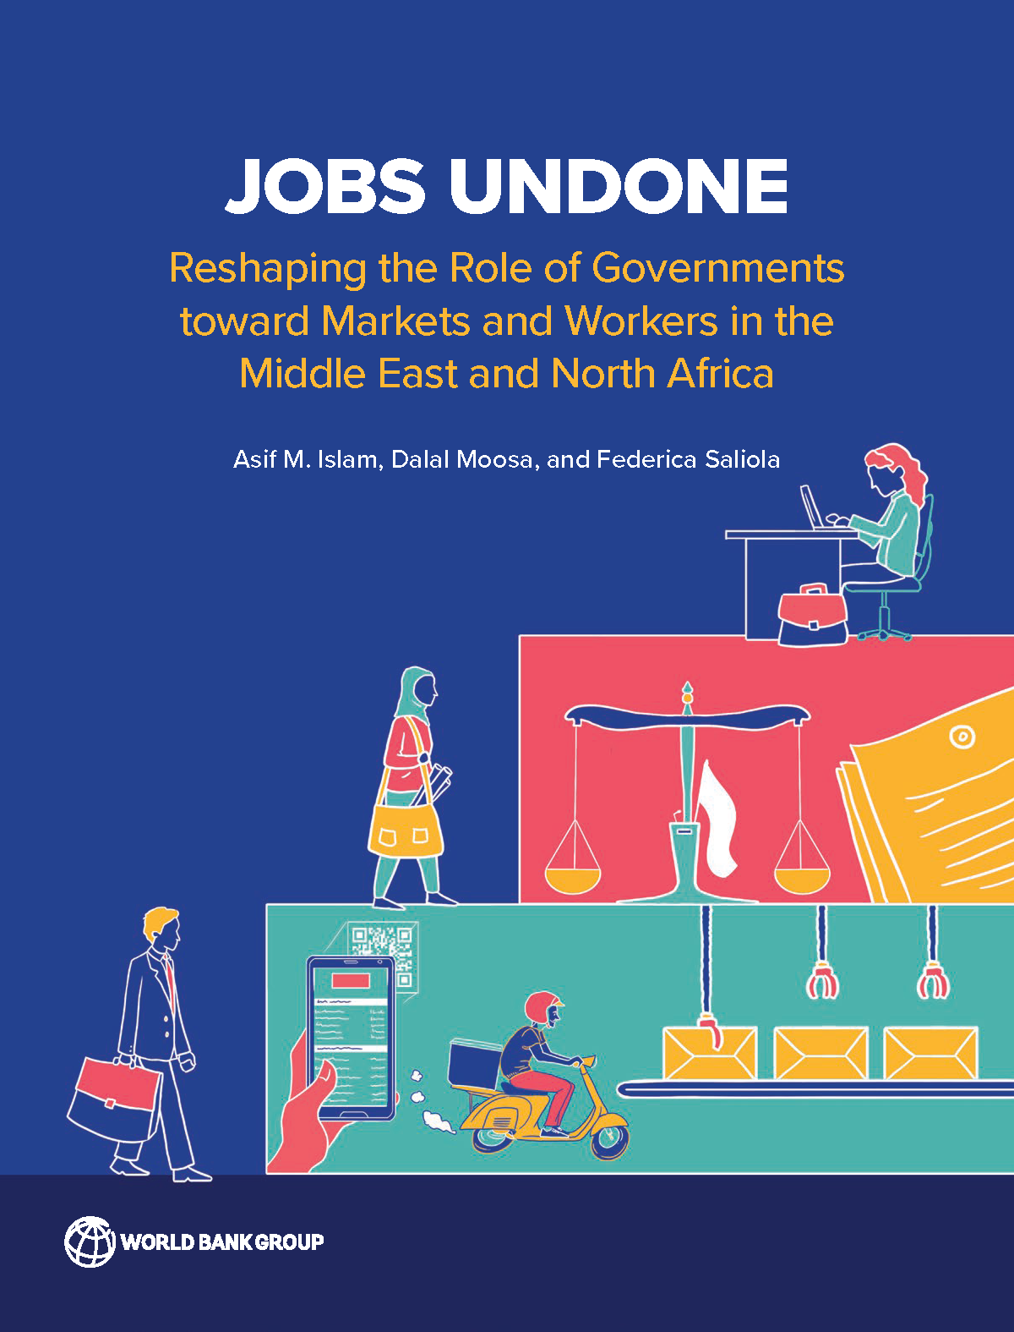
THE SCOPE OF THE REPORT
Focused on examining how lack of contestability impacted job creation
The case studies looked at how technology enhances contestability and boosts entrepreneurship
Seven Case Studies
KSA
Bahrain
Egypt
Morocco
Jordan
WBG
Lebanon
Examined sectors
Education
Health
Delivery and supply chain
Manufacturing
READ THE REPORT

Slide 5
APPROACH TO UNDERSTANDING HOW TECHNOLOGY BOOSTS ENTREPRENEURSHIP
Key Question
HOW CAN TECHNOLOGY
…level the playing field?
…enhance access to the market and reduce unfair competition?
…provide access to marginalized talent, particularly to youth and women?
01
Human-centered Design – focus on the entrepreneur's experience
02
How entrepreneurs enter and exit the market
Link macro-level quantitative indicators (regulations and policies) with the entrepreneur’s own challenges: Gender law, labor market regulations, and product market regulations.
03

Slide 6
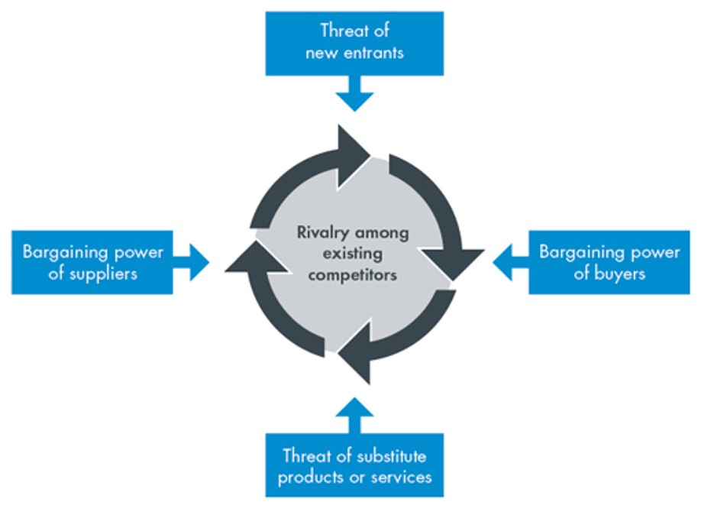
KEY LEARNINGS
Technology tends to…
enhance contestability by reducing sunk cost
Easy entry and exit to the market by new entrepreneurs
enhance market access and scalability
allow for better access to talent remotely
technically change the dynamic of the political economy by empowering entrepreneurs to compete with SOEs
facilitate access to seed funding through fintech models – empowering youth who are talented but have limited access to funding
enhance management and operations
enhance customer outreach and marketing by changing the conventional marketing approach
allow for community-based and purpose-driven enterprises

Slide 7
HIGHLIGHTING THREE CASES
LINK
LINK
LINK
Jordan
Egypt
Morocco
An online learning platform to deliver accessible, quality education
A platform to deliver pharmacy services
A safe carpool platform to share trip costs

