Slide 1
SCALING UP COMMUNITY OF PRACTICE: EDUCATION WORKING GROUP WEBINAR
COVID-19 Crisis
April 9, 2020

Slide 2
Agenda
Welcome, purpose, introductions
Quick overview of implications of COVID-19 crisis on children’s education and well-being
Lessons from humanitarian sector
Immediate needs and gaps & potential WG role
Medium- and long-term needs & potential WG role
Wrap up & next steps

Slide 3
WEBINAR OBJECTIVES
Discuss immediate and longer-term impacts of COVID-19 on children’s education.
Share information about current education efforts underway in response to COVID-19 crisis and where the education community can learn from other efforts.
Explore where the Education Working Group can contribute and add value, in the short- and long-term.

Slide 4
Impacts OF COVID-19 crisis on children’s EDUCATION & well-being

Slide 5
IMMEDIATE IMPACTS
Interrupted learning:
1.57b affected learners (91.3% of total enrolled)
188 country-wide closures
Increased school dropouts
Exacerbated inequities in access & quality
Disproportionate challenges for girls; refugee, displaced, and migrant children; children with disabilities; children in low resource and remote contexts; etc.
Notes:
Stats from April 7, 2020

Slide 6
IMMEDIATE IMPACTS
Interruption of school feeding programs
368m children missing out on school meals
Child protection risks
Increased risk of domestic and sexual violence and abuse, neglect, child labor, forced marriage, and trafficking
Lack of access to essential social services provided at schools and learning centers, including mental health care and psychosocial support
Notes:
Stats from April 7, 2020

Slide 7
MEDIUM- & LONG-TERM IMPACTS
Children deprived of their right to education
Deeper inequities in access & learning
Exacerbated gender inequality in education & spillover effects
Spillover effects of economic hardships on families, exacerbation of intergenerational poverty
Decreased funding for the education sector
Notes:
Can delete

Slide 8
POTENTIAL OPPORTUNITIES
More space for innovation in education systems – greater appetite for experimentation, adaptation to 21st century realities
Better emergency preparedness; more resilient education systems
More data & learning about remote education, including ed tech
More parental engagement in education
Greater appreciation for and respect for teaching profession
More national attention & investment to extending internet connectivity
More PPPs emerging
Notes:
Can delete

Slide 9
MANY EFFORTS TO COLLECT, CURATE, AND SHARE RESOURCES & DATA
Non-exhaustive list:
UNESCO tracking impact on education & compiling national education plans and policies: https://en.unesco.org/covid19/educationresponse; https://planipolis.iiep.unesco.org/
INEE compiling resources to support provision of education in affected places; hosting webinars & blog series: https://inee.org/collections/coronavirus-covid-19-resources
Global Education Cluster compiling global, regional, country-level resources: https://educationcluster.app.box.com/s/b15ifcny1wh0v6kujujfk8csh5o783xa
UNICEF issued IASC guidance with WHO and IFRC on COVID-19 prevention & control in schools: https://educationcluster.app.box.com/s/qgyxvghxv4mhluy790h6s9jf6ek1q9l4
World Bank tracking impact on education and compiling key resources: https://www.worldbank.org/en/data/interactive/2020/03/24/world-bank-education-and-covid-19

Slide 10
MANY EFFORTS TO COLLECT, CURATE, AND SHARE RESOURCES & DATA
Non-exhaustive list:
Harvard & OECD developing decision-making framework to guide education decision-makers to develop & implement effective responses
Global Business Coalition for Education compiling resources & tools from ~75 global companies: https://bit.ly/2x9dUuc
mEducation Alliance compiling landscape reviews and other resources: https://www.meducationalliance.org/?page_id=59
Ed Tech Hub sharing open educational resources: https://edtechhub.org/oer/
HundrED & OECD publishing curated list of resources and webinars to train educators: https://hundred.org/en/collections/quality-education-for-all-during-coronavirus
Innovation Edge sharing parenting resources: https://innovationedge.org.za/parenting-resources/

Slide 11
Lessons from other crises
Rebecca Winthrop, Co-Director and Senior Fellow, Center for Universal Education, Brookings Institution

Slide 12
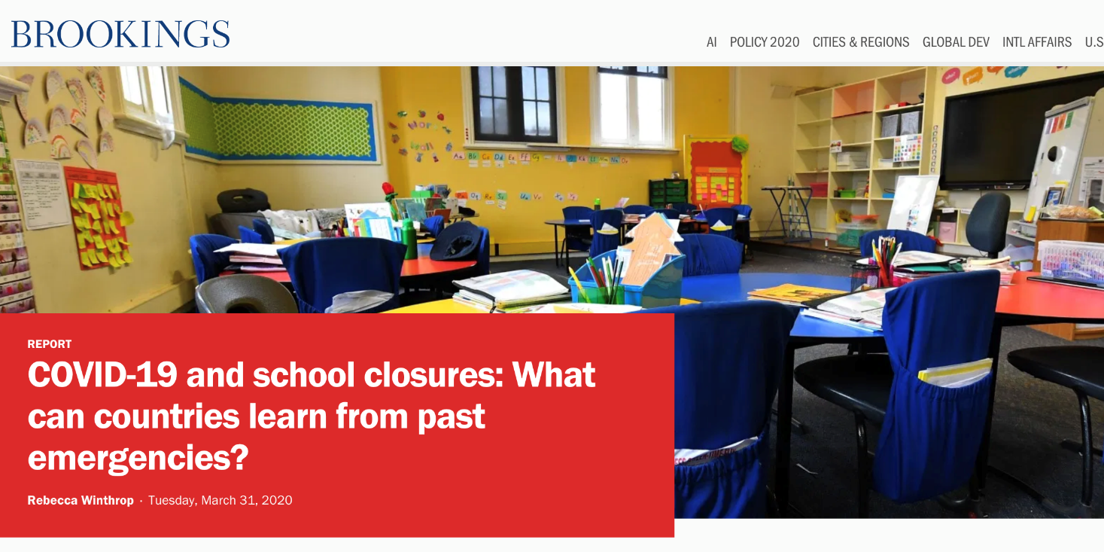
Education in Emergencies Principles Key:
Life-saving messages a priority
Emergency response with a development vision
Do no harm
Build back better

Slide 13
needs and gaps in low- & middle-income countries
Mary Burns, Senior Learning Technologist, Education Development Center

Slide 14
What’s happening with distance education
Issues
Moving forward
(Organized by Themes)

Slide 15
Theme 1: Most countries have turned to “online learning”…well, that’s the plan anyway
United States
~13,000 school districts
~100,000 public schools
47 states closed school
54 million out-of-school
Notes:
In the richest country in the world, most US school districts are still not providing any online instruction

Slide 16
Theme 2: There’s a lot of “definitional variability”
No online learning
Access to curated or subscription services
Suggested educational resources-no instruction
Instruction via webinars
Offline work with teacher check-ins
Sending curriculum resources-no instruction
Full instructional delivery, support, assessment, monitoring via LMS/Google Classrooms

Slide 17
Brazil
~5,570 municipalities
26 states
Education carried out by states and municipalities

Slide 18
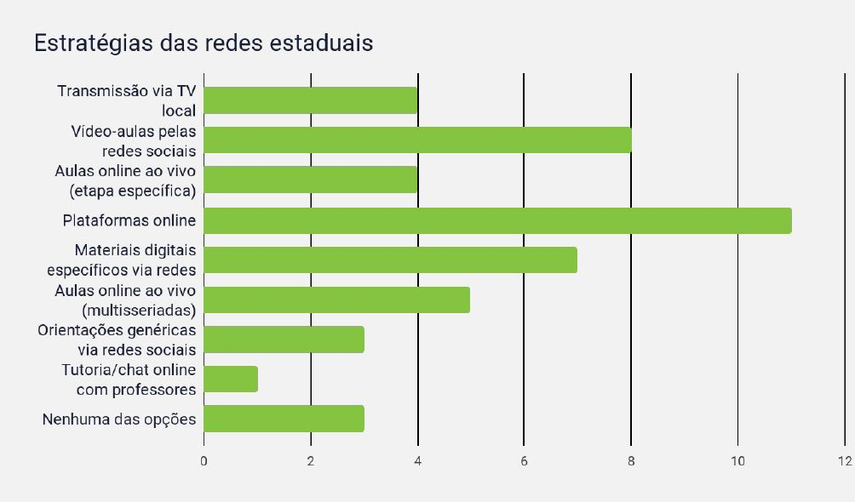
N=12 states

Slide 19
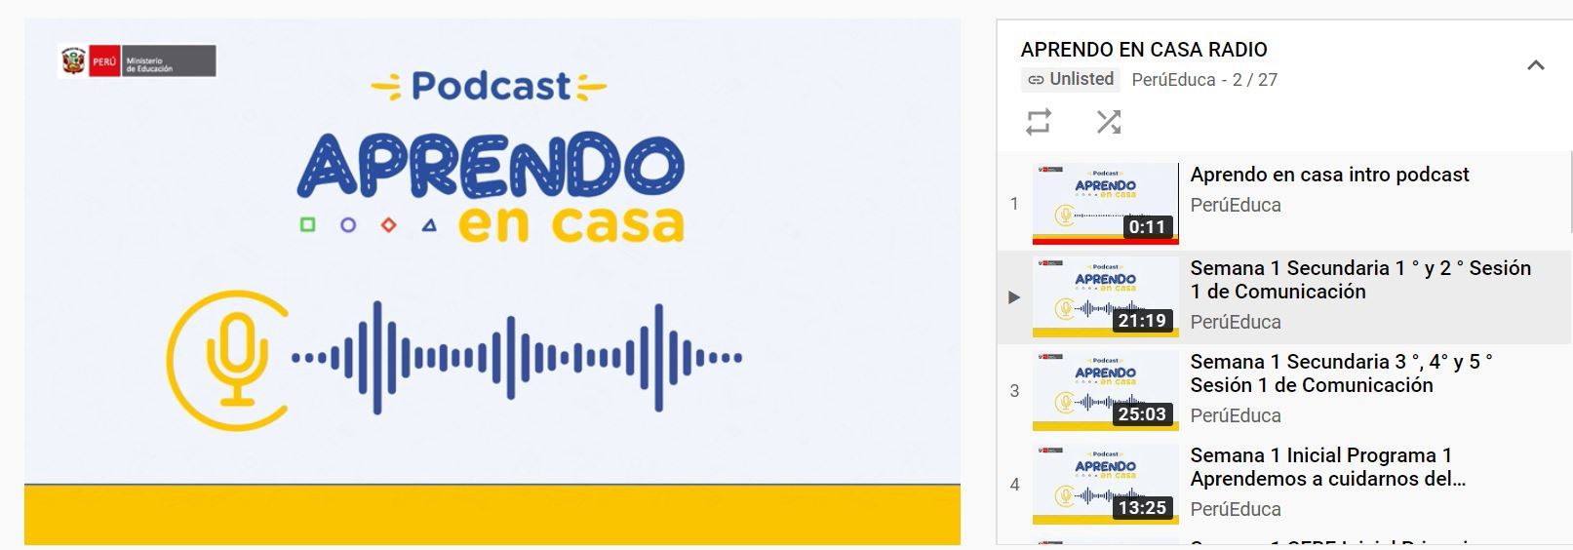
Theme 3: Online learning alone can’t do it. It needs help from some old friends….
Peru
Launched online program-Aprendo en Casa (89% households have Internet access)
10% of rural households have Internet access
35% of teachers have home Internet/technology access

Slide 20
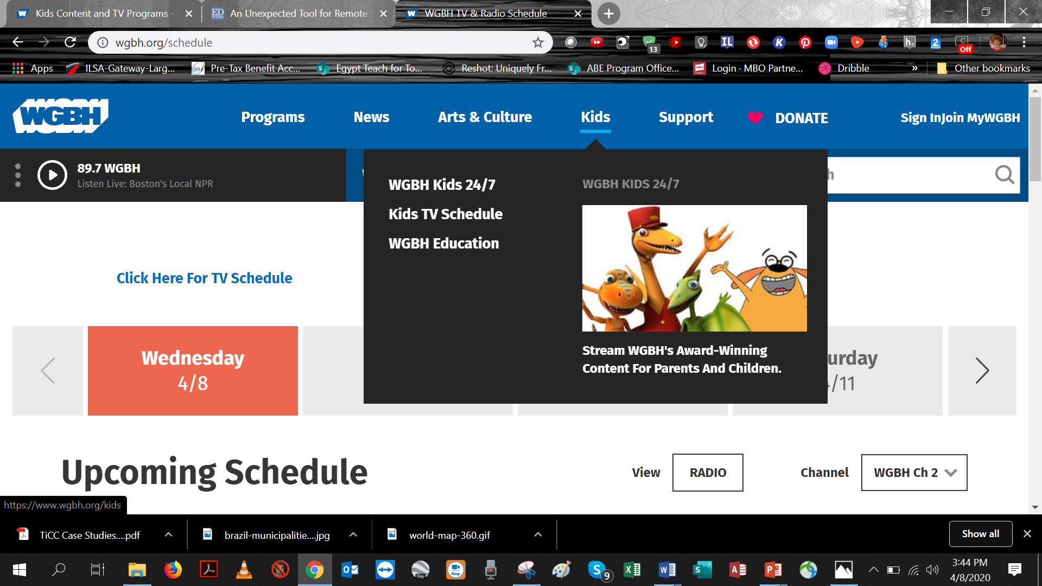
TV: It’s baaack….and it’s not just for Netflix anymore
75% of the world’s population has access to TV
All 50 US states are broadcasting educational TV
France, Australia, China, Canada, South Africa, Botswana, Ecuador
State-owned, community, subscription and educational TV channels

Slide 21
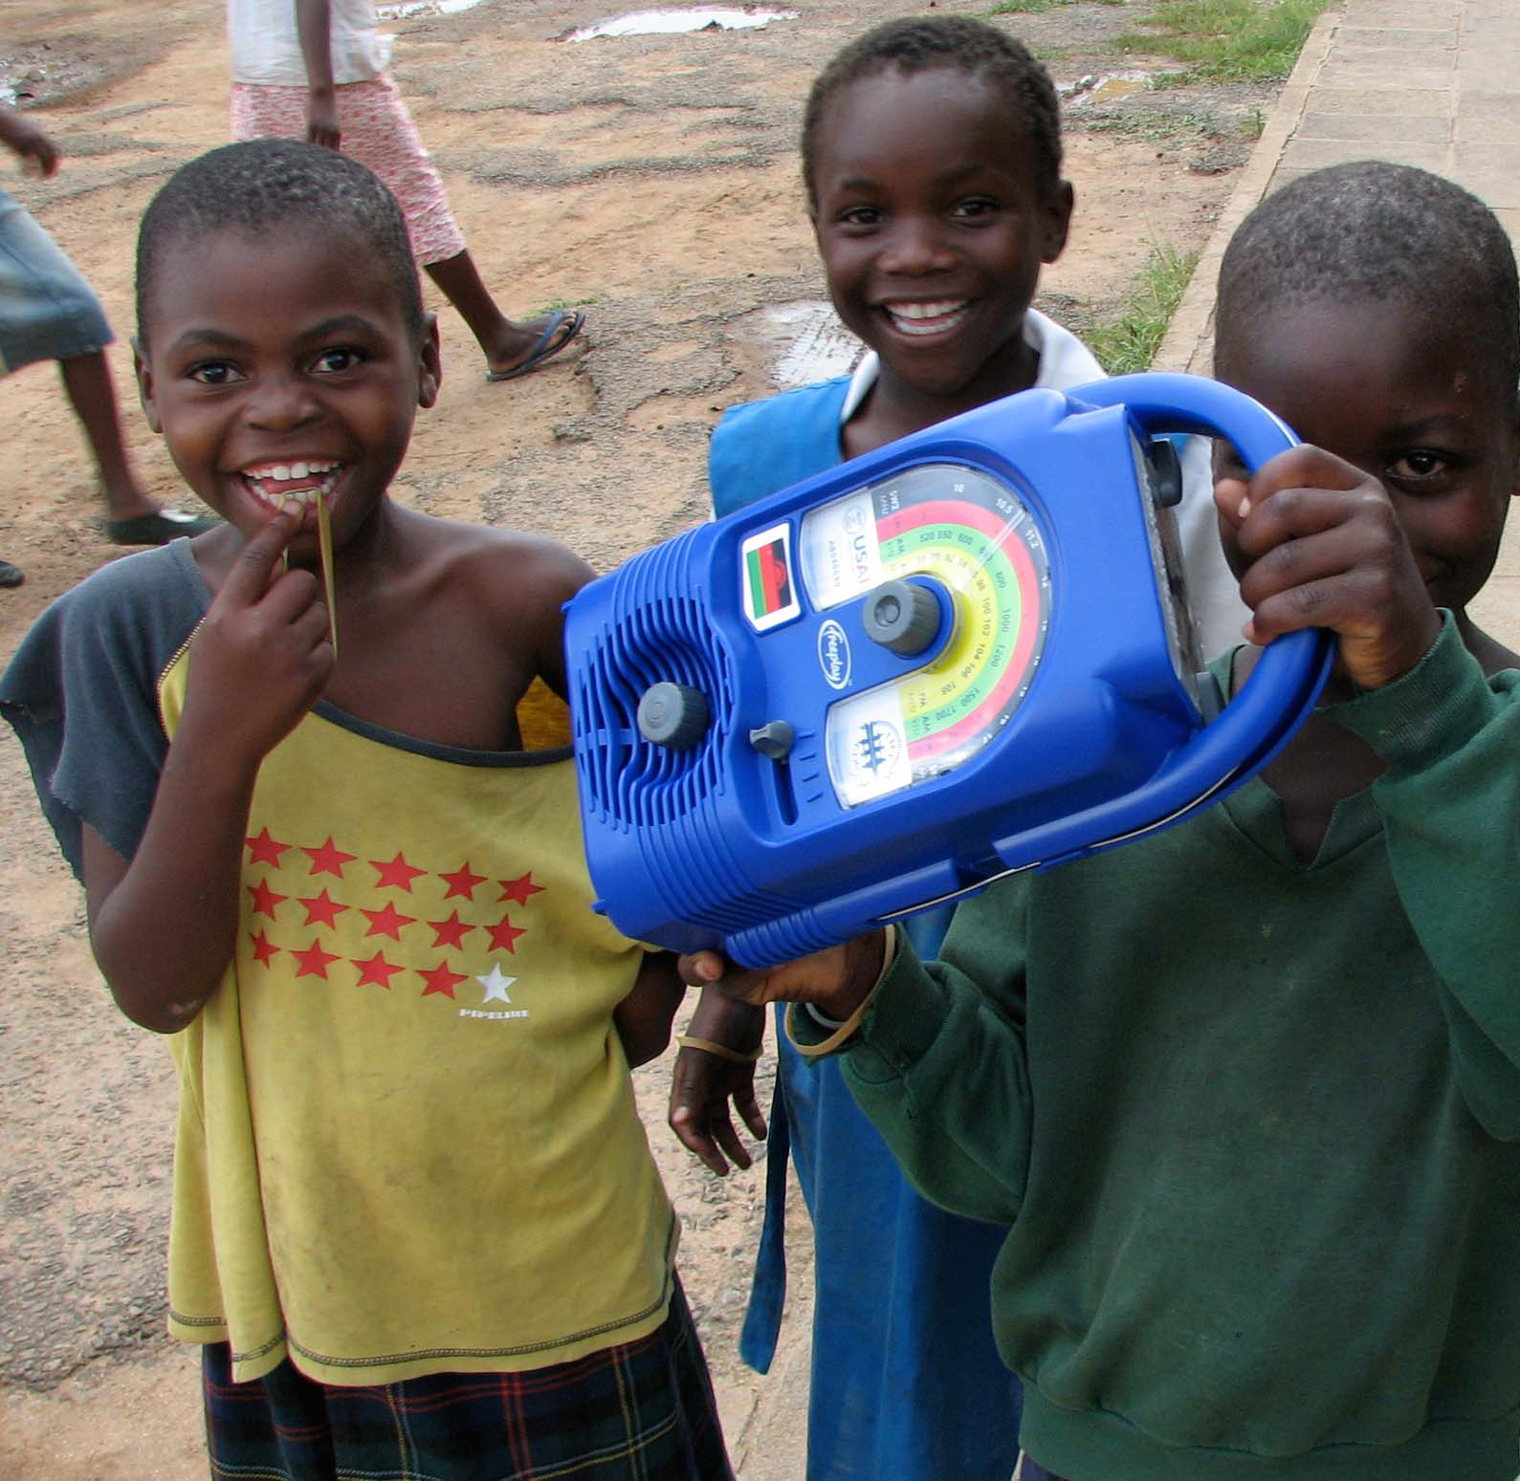
90%
Radio: “Old” is the new new
80-90% of SSA households have access to radio
Massive reach
Broadcast radio, radio dramas, Interactive Radio Instruction
Learning at Home in Times of Crisis Using Radio | edc.org
21

Slide 22
IRI Around the World
Pakistan
Haiti
Dominican Republic
Nepal
Honduras
Mali
Nigeria
South Sudan
India
El Salvador
Guinea
Ethiopia
Philippines
Liberia
Somalia
Colombia
Guyana
Rwanda
Democratic Republic of Congo
Tanzania
Indonesia
Bolivia
Zambia
Zanzibar
Malawi
Madagascar
Learning at Home in Times of Crisis Using Radio | edc.org
22

Slide 23
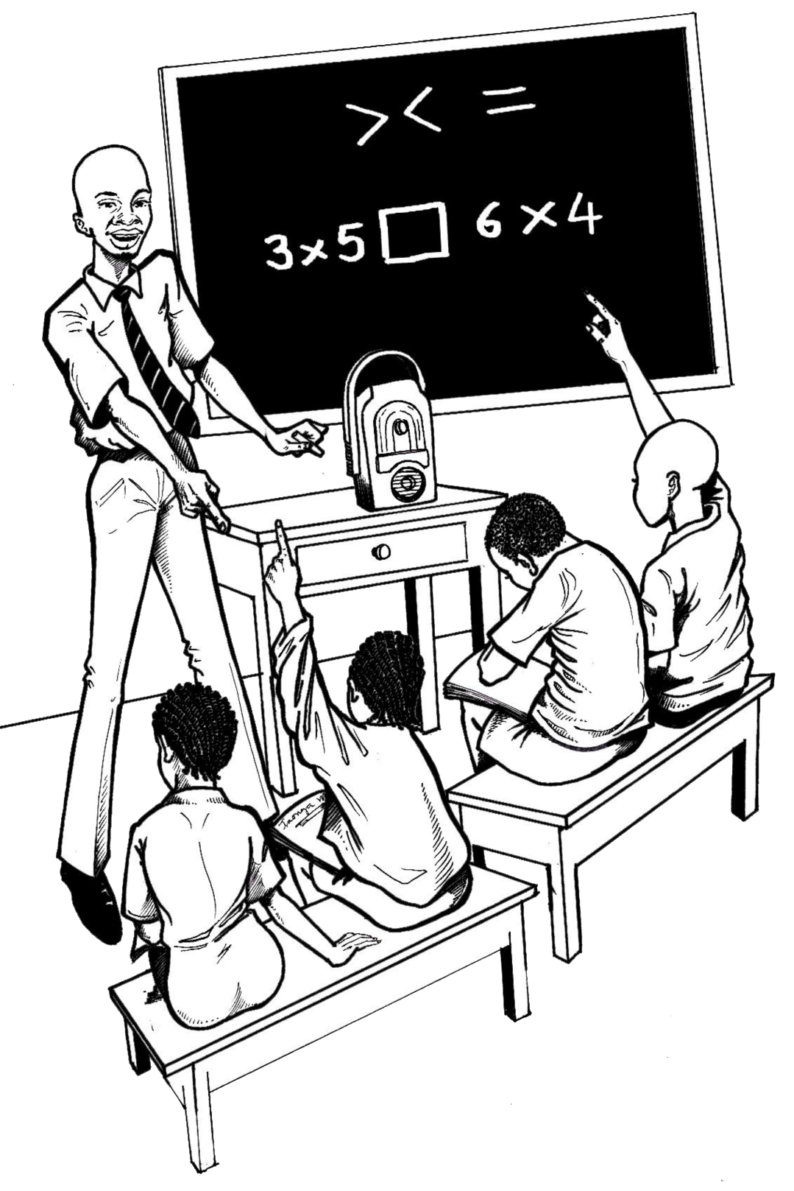
Nigeria

Slide 24
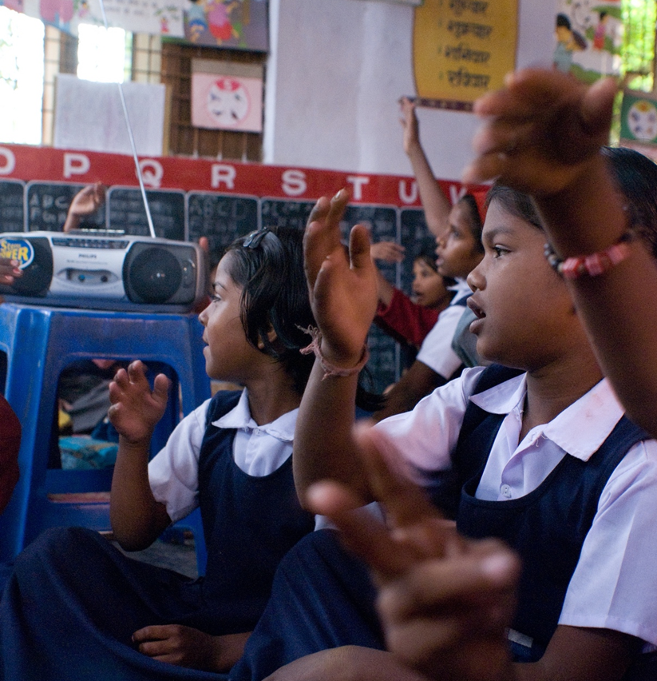
Why IAI?
Theme 4: COVID 19 is not just a health crisis; it’s an education crisis…
IAI?
Potentially devastating education systems in poor and fragile countries
It is being (and will be) borne by the poorest students in the world
Children with disabilities, special needs learners, refugees, poor children (depend on school meals, services)
US: 14% of households lack Internet access. Most have school-age children and earn <$50,000

Slide 25
Theme 5: Much of this crisis could have been avoided
Failure to plan: 2000-2020: 9/11, SARS, H1N1, MERS, ebola, Snowmageddon, variety of other meteorological disruptions
Lack of vision around technology: We’ve treated technology infrastructure as a “nice to have” or “what rich countries get” vs. a “must have” and “what poor countries desperately need”
Lack of e-readiness: School’s ICT infrastructure, connectivity, curriculum and digital content, e-administration, teacher ICT readiness and teacher development and support
Failures of governments, donors, business: Vision about, policy for, investment in technology that has created massive inequities between/within countries

Slide 26
Theme 6: As a result, the initial results of online learning are not pretty
Teachers don’t know how to teach online
Students don’t know how to learn online
Lack of planning, design→ impoverished learning experience
Online learning has proved to be exclusionary: Not serving kids special needs, who take certain classes, with IEPs, etc.
Lack of familiarity with the tools used in online learning
Pushed learning into home environments that may/can not motivate success in learning online Disarticulation between what is taught in the classroom and what is being taught online.

Slide 27
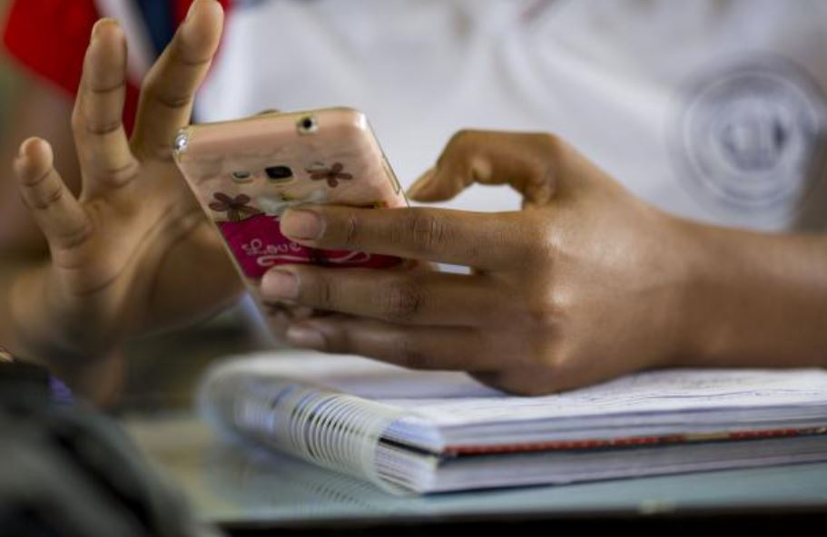
Theme 7: Technology must be an integral part of national education systems
Dispense with unproductive arguments about whether educational technology (computers) improves learning
Technology offers scale, access and uninterrupted education during many (not all) disruptions
Time to leverage technology people own (phones, radio) for education purposes
As a COP focused on scale in education, we can advocate for use of technology and deeper understanding of scale

Slide 28
Theme 8: Within households, new patterns of educational inequality are being layered over old ones
Turned parents/caregivers into de facto teachers and principals: Devolved teaching responsibility to parents, many of whom are not at all equipped (or able to socially isolate)
Digital divide causes all kinds of divides: Students in underserved schools and communities are least likely to have access to technology/more likely to share technology participation gaps; less likely to seek and receive help on schoolwork; less likely to use tech for academic purposes; engage in passive digital practices and “consumption vs production-like orientations”
Parental engagement is key to student learning: With “remote learning,” parents need basic digital literacy skills to be able to be engaged in their child’s learning.

Slide 29
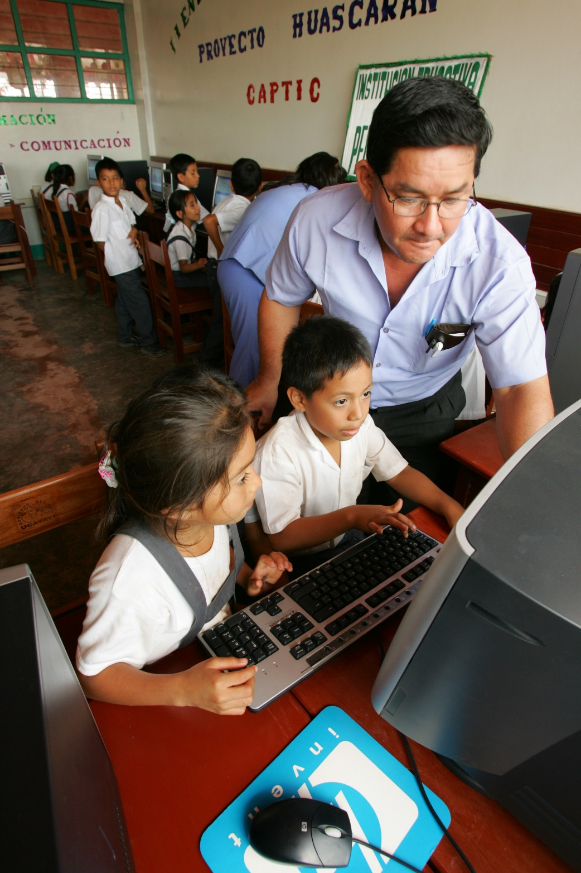
Theme 9: We need new ways of working
Rebuild national education systems
Sector wide vs. projects
Long-term investments vs. short project cycles
Donors working together
Implementers collaborating not competing
We can’t let this crisis go to waste: Act now and plan for a better educational future

Slide 30
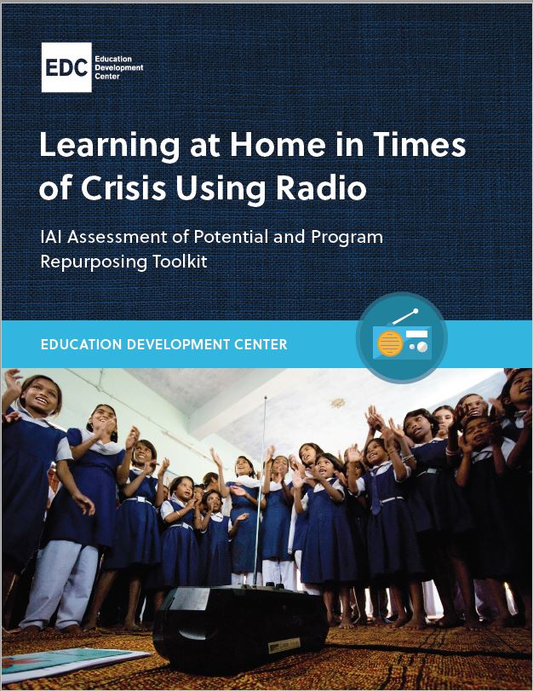
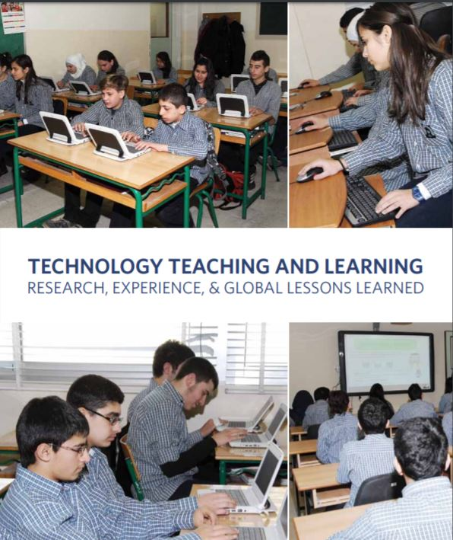
EDC Technical Assistance
Distance education for teachers and students (IRI, online)
Support for repurposing radio programs
Develop/facilitate parent orientation
Consultation on delivery mechanisms

Slide 31
Group discussion

Slide 32
What immediate needs are we seeing or hearing about in countries to help children continue their education?
What gaps are we observing between these needs and the current work happening?
How can this WG play a constructive role in filling these gaps, especially around connecting field staff to resources, sharing or translating resources, etc.?

Slide 33
What medium- and long-term needs do we anticipate seeing in countries to help children continue and/or return to their education?
How might this working group contribute to the long-term response?

Slide 34
NEXT STEPS
Notes:
Last slide

